Slide 1
Donor Retention:
Current Rates Are Plummeting
What Fundraisers Can Do to Reverse the Trend!
Jay B. Love
CEO & Co-Founder
Bloomerang

Slide 2
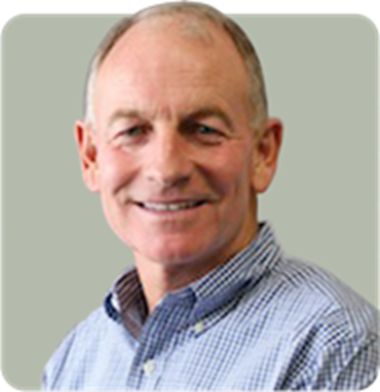
Your Presenter
3
Jay B. Love
• 30 Years of Technology Leadership
• Over 20,000 Database Installations
• Former Founder & CEO of eTapestry
• Former CEO of Master Software/Fund-Master
• AFP Board Member
• AFP Ethics Committee Chairman
• Center on Philanthropy at IU Board Member
• Innovation Fund at Butler University Board Member
• Gleaners Food Bank Board Member
• Co-Chair of Indianapolis YMCA Capital Campaign

Slide 3
Do you know your Retention %?
In our surveys, less than 5% of fundraising offices know their current Retention Rate . . .

Slide 4
What does a 10% increase in Donor Retention rates mean in terms of LIFETIME dollars raised?
50%
100%
150-200%

Slide 5
Is Retention important for NPO’s?
Improving donor retention rates by 10% can improve LIFETIME dollars raised by?
150-200%!
(Do we have your attention yet?)

Slide 6
This scares most NPO Board Members
Donor Attrition Over Five Years
# of Donors | Attrition Rate | Donors Remaining After 1 Year | Donors Remaining After 2 Years | Donors Remaining After 3 Years | Donors Remaining After 4 Years | Donors Remaining After 5 Years
1,000 | 20% | 800 | 640 | 512 | 410 | 328
1,000 | 40% | 600 | 360 | 216 | 130 | 78
1,000 | 60% | 400 | 160 | 64 | 26 | 10
Let’s dig even deeper into “actual” NPO data . . .

Slide 7
Fundraising Effectiveness Project (FEP)
A project to help nonprofit organizations
measure and compare
.

Slide 8
Fundraising Effectiveness Survey Report “FEP”
Participating Donor Software Firms:
Donor2/Campus Management Corporation
PhilanthrAppeal (FundTrack Software)
DonorPerfect Fundraising Software
The Raiser’s Edge ® (Blackbaud)
eTapestry
Avectra
Bloomerang
Sage Software
MatchMaker FundRaising Software
Telosa Software (Exceed!)
Metafile

Slide 9
2012 FEP Data on Donor Retention Rate
Donor Retention Rate was 39%
Donor Attrition was 61%!

Slide 10
Yes, your eyes read correctly:
More than SIX out of every TEN Donors from the previous year did NOT donate at all the next year!

Slide 13
Addressing the Retention Problem!
Is it a Donor Relationship Issue?

Slide 14
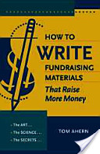
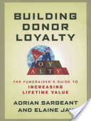
Cue the ExpertS:
Mr. Tom Ahern
Bloomerang Donor Communications Head Coach
One of the world’s top authorities on donor communications
Author of 4 books on Donor Communications
Winner of 3 prestigious international IABC Gold Quill awards
Dr. Adrian Sargeant
Bloomerang Chief Scientist
Professor of Fundraising at the Center on Philanthropy at Indiana University holding what is presently the world’s only endowed chair in that discipline.
Top 10 Most Influential People in Fundraising
Renowned expert on Donor Retention and Donor Loyalty

Slide 15
How Do Two Long Term Experts in Separate Corners of the Non-Profit World Synch Up?
Common Desire to Address an Ever Increasing Crisis in the Sector We Both Love

Slide 16
Donor Retention Best Practices
Dr. Adrian Sargeant
Bloomerang Chief Scientist
“A 10% improvement in retention can double the LIFETIME value of your donor database!”

Slide 17
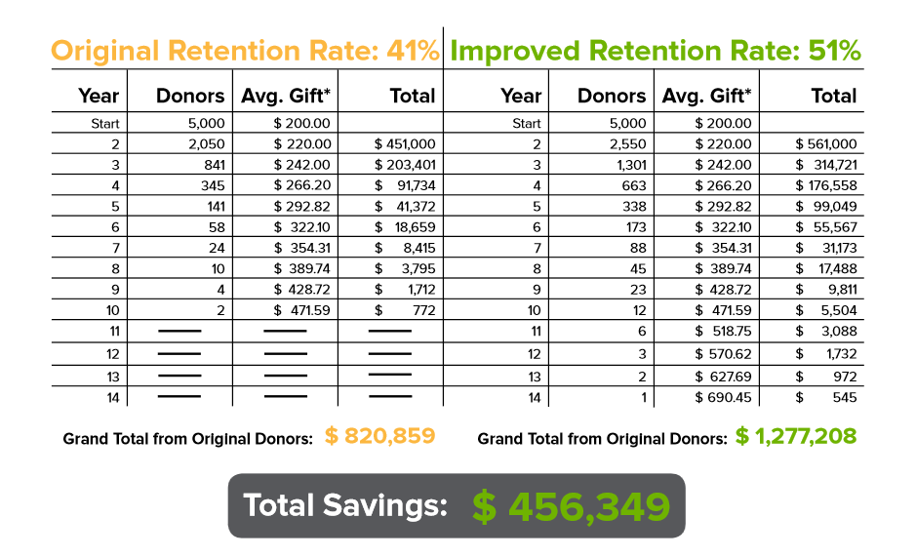
Donor Retention Made Simple

Slide 18
Figuring Your Donor Retention Rate
# of Donors in Current 12 Months
(from the previous years pool)
Divided by
# of Donors in Previous 12 Months

Slide 19
Figuring Your Dollar Retention Rate
Total Dollars from Donors in Current 12 Months
(from the previous years pool)
Divided by
Total Dollars from Donors in Previous 12 Months

Slide 20
The Extra Importance of Dollar Retention Rate
$0 - $25
$26 - $100
$101 - $1,000
$1,001 - $10,000
$10,000 & Up (50% of Total)
(Where do you desire
a 10% change?)

Slide 21
Beyond Dollar Retention Rate?
Seattle’s Lakeside Upper School counts … Bill Gates among its alumni. Rumor has it a fundraiser for the high school called Gates, who asked: “How much is everyone else giving?” About $75 he was told. “So put me down for $75,” said Gates.
-- Forbes, Jan 22, 1996, p. 16

Slide 22
Defining Lifetime Value »
“The total net contribution that a customer/donor generates during his/her lifetime in your database”

Slide 23
Lifetime Value or “LTV”
LTV = ∑Ci
Where
c = net contribution from each year’s fundraising activity
i = expected duration of each relationship in years

Slide 24
Value Segments »
$1000 +
Value
Time
$500 - $1000
$100 - $500
$25 - $100
$25 and under annually

Slide 25
Why Do Customers Leave? (can this apply to donors . . .)
Death 1%
Relocation 3%
Won by Competitor 5%
Bad Complaint Handling 14%
Lack of Interest from Us 77%

Slide 26
Key Reasons For Donors Leaving
No longer able to afford support
No memory of ever supporting!
Organization asked for inappropriate sums
Feeling that other causes are more deserving
Not reminded to give again
Organization did not inform how monies were used
Did not feel connected!

Slide 27
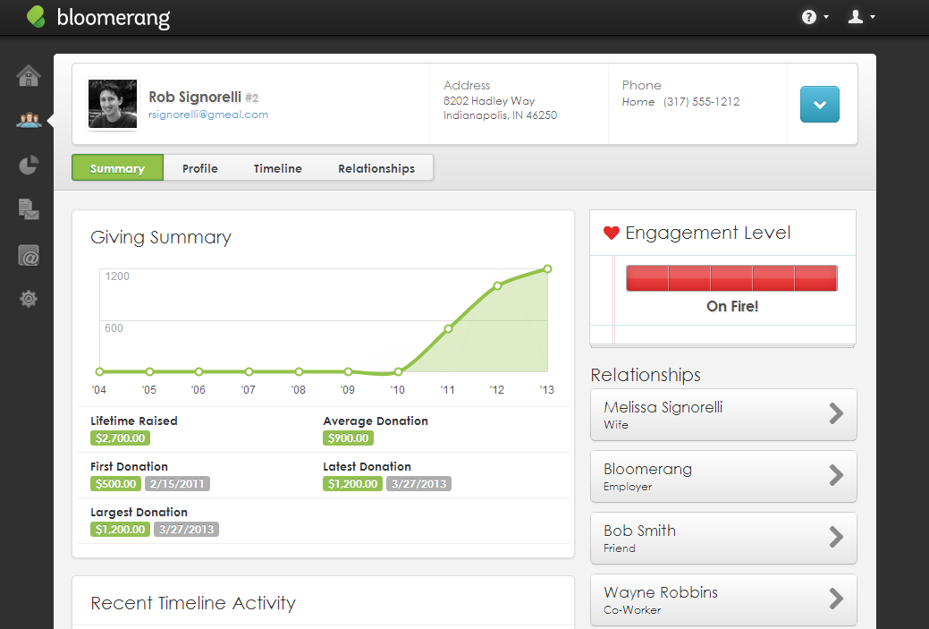
Notes:
Donor Engagement

Slide 28
Automatic Engagement Factors
Recency and pattern of giving
Cash donors vs. sustaining donors
# of years giving +
Upgrade / Downgrade + -
Lapsed -
Event attendance +
Opens email +
Click links in emails +
Unsubscribes from email -
Has stated communication preferences +
Has inbound interactions +
Has soft credits +
Volunteers +
Social Media (coming soon)
…and a whole lot more!

Slide 29
6 Key Retention Drivers (That can double lifetime value)
Drip feed mission performance data
Connect often (1st 90 Days!)
Be personal (SEGMENT via DB)
Develop like a good personal friendship
Find & use numerous human connectors
Always communicate what monies are doing!

Slide 30
Donor Communication Best Practices
Mr. Tom Ahern
Bloomerang Donor Communications
Head Coach
"Successful direct mail appeals are quite simple. At heart, they are love letters to donors & prospects, woven through with clear cries for help."

Slide 31
You’re trying for “mental nods.”
Secret to Success #1 »

Slide 32
Your appeal is NOT about how wonderful your organization is. Your appeal IS about how wonderful the donor is.
Secret to Success #2 »

Slide 33
1st paragraph: 10 words or less.
Secret to Success #3 »

Slide 34
Multiple asks
Secret to Success #4 »

Slide 35
Don’t bore me.
Secret to Success #5 »

Slide 36
Know your SMIT. Single Most Important Thing.
Secret to Success #6 »

Slide 37
Get them into a fight.
Secret to Success #7 »

Slide 38
Make a promise.
Secret to Success #8 »

Slide 39
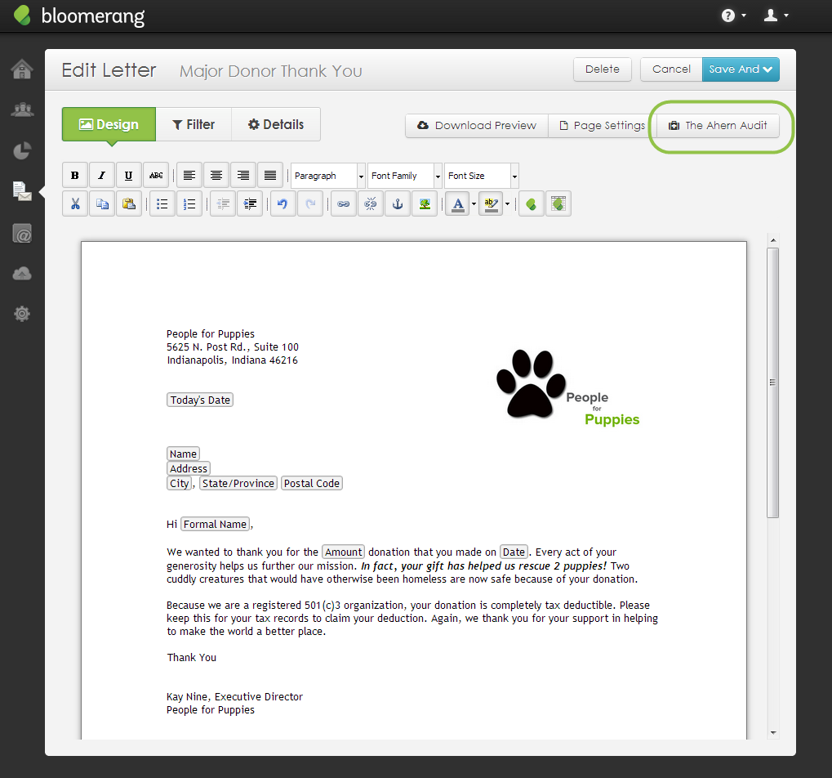

Slide 40
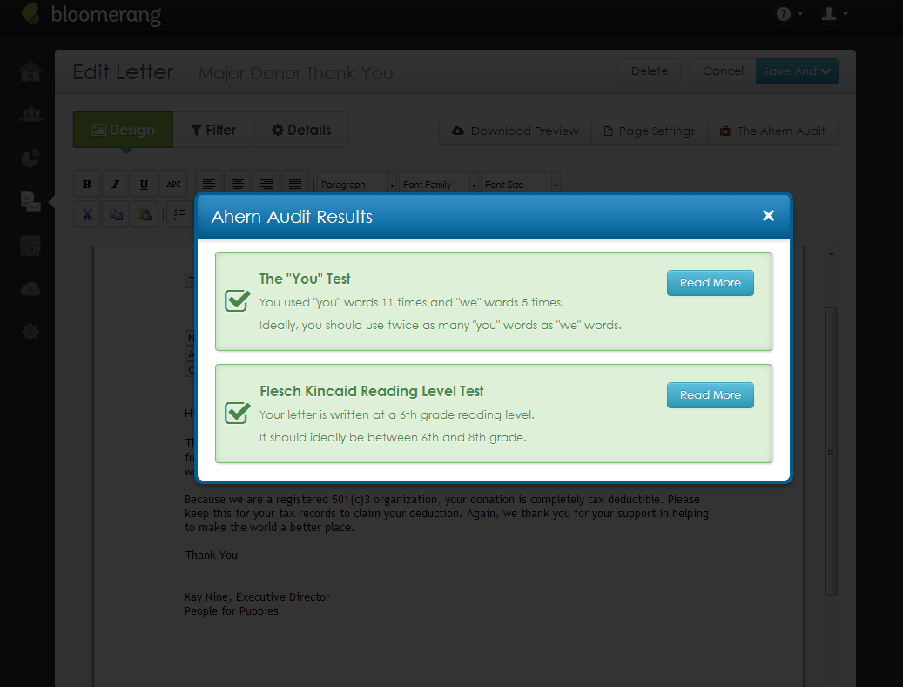

Slide 41
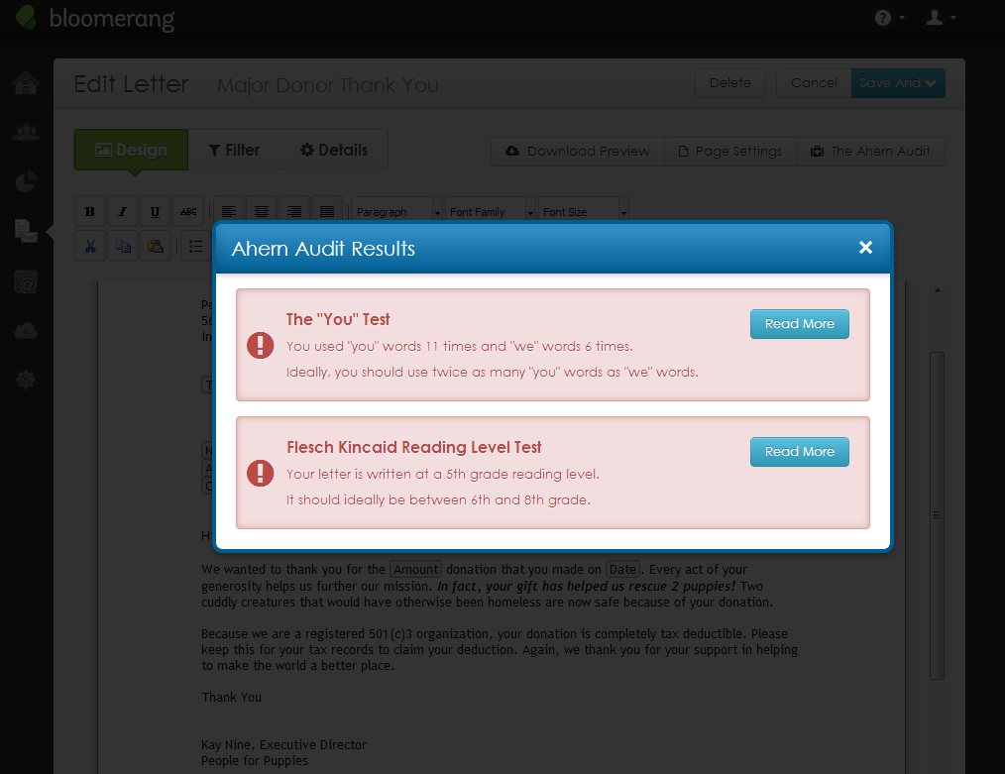

Slide 42
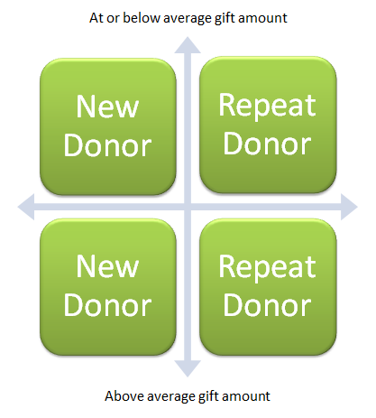
Engagement Begins With The Thank You!

Slide 43
5 Acknowledgment Principles (Drastically Improve First Year Donor Retention)
48 Hour Rule
Be Different Than the Rest
Handwritten Rule Written Communications
State Exactly What the Monies will Fund
Call or See in Person as Often as Possible

Slide 44
5 Communication Strategy Practices (Involve Your Entire Fundraising Team)
Fully Map a Track for Each Key Segment
Survey in 1st 90 Days, Then “Honor”
Involve Human Connectors
Nurture Means Personal
Never Forget the “You” Test for EVERY “Touch”

Slide 45
Questions? Presenter: Jay B. Love jay.love@bloomerang.co
45

